Slide 1

Gokaraju Rangaraju Institute of Engineering and Technology (Autonomous) Department of Data Science Mini Project Work (CSE(DS))
Review 4: Execution Cycle 1 Presentation
Batch No - B3
Presented by:
1. B. Karthikeya (22241A6771)
2. B. Abhilash Reddy (22241A6775)
3. B. Sushanth (22241A6776)
Under the Guidance of:
Dr. R.P. Ram Kumar
Professor
CSE(DS) Department

Slide 2
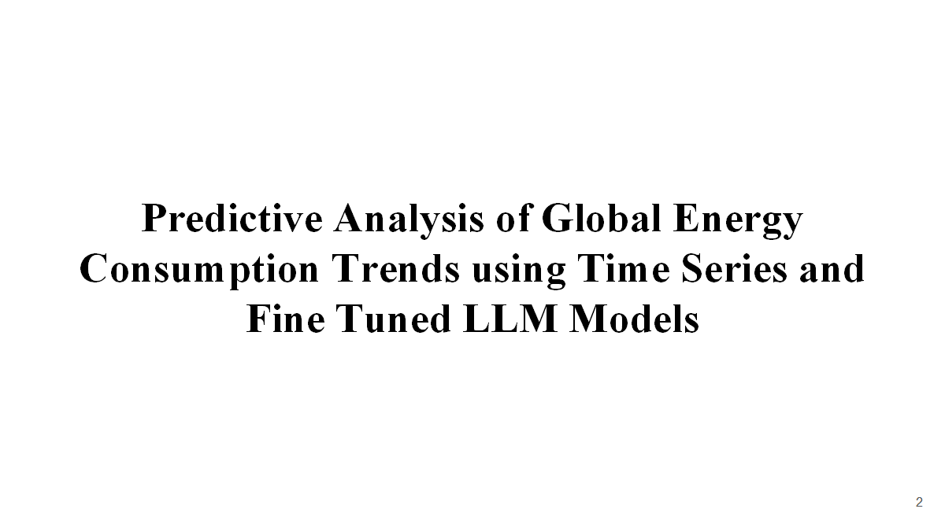

Slide 3
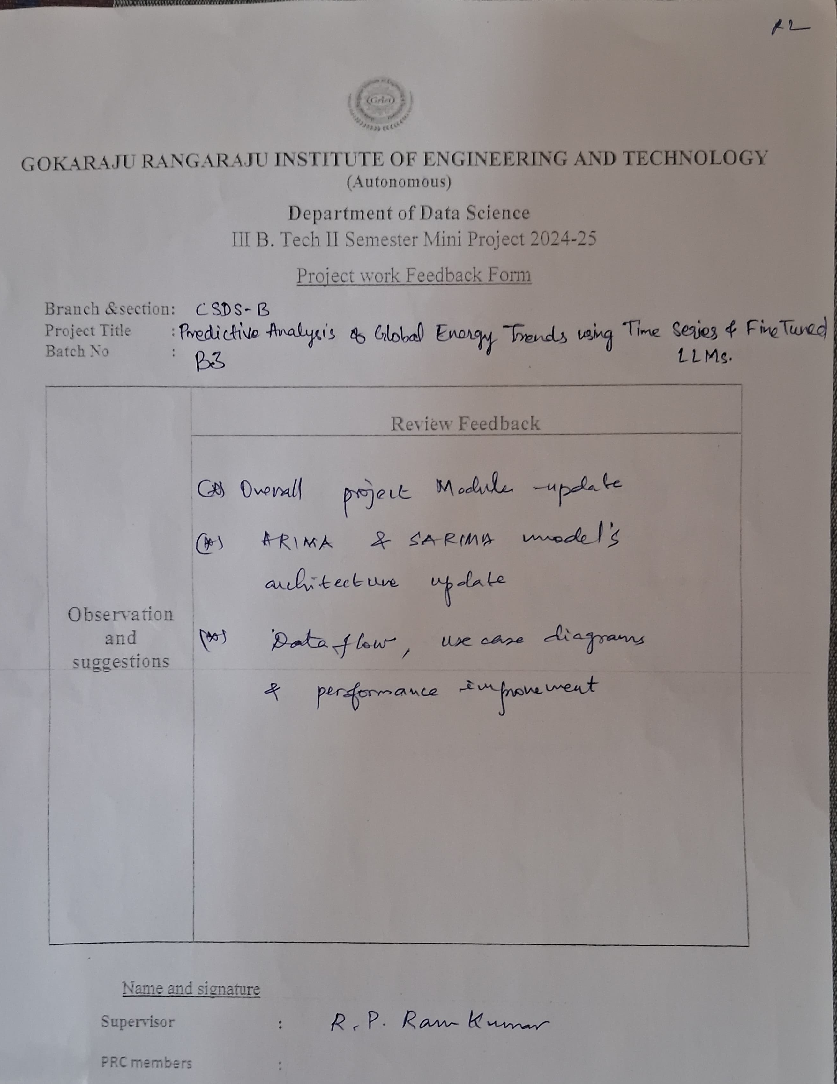
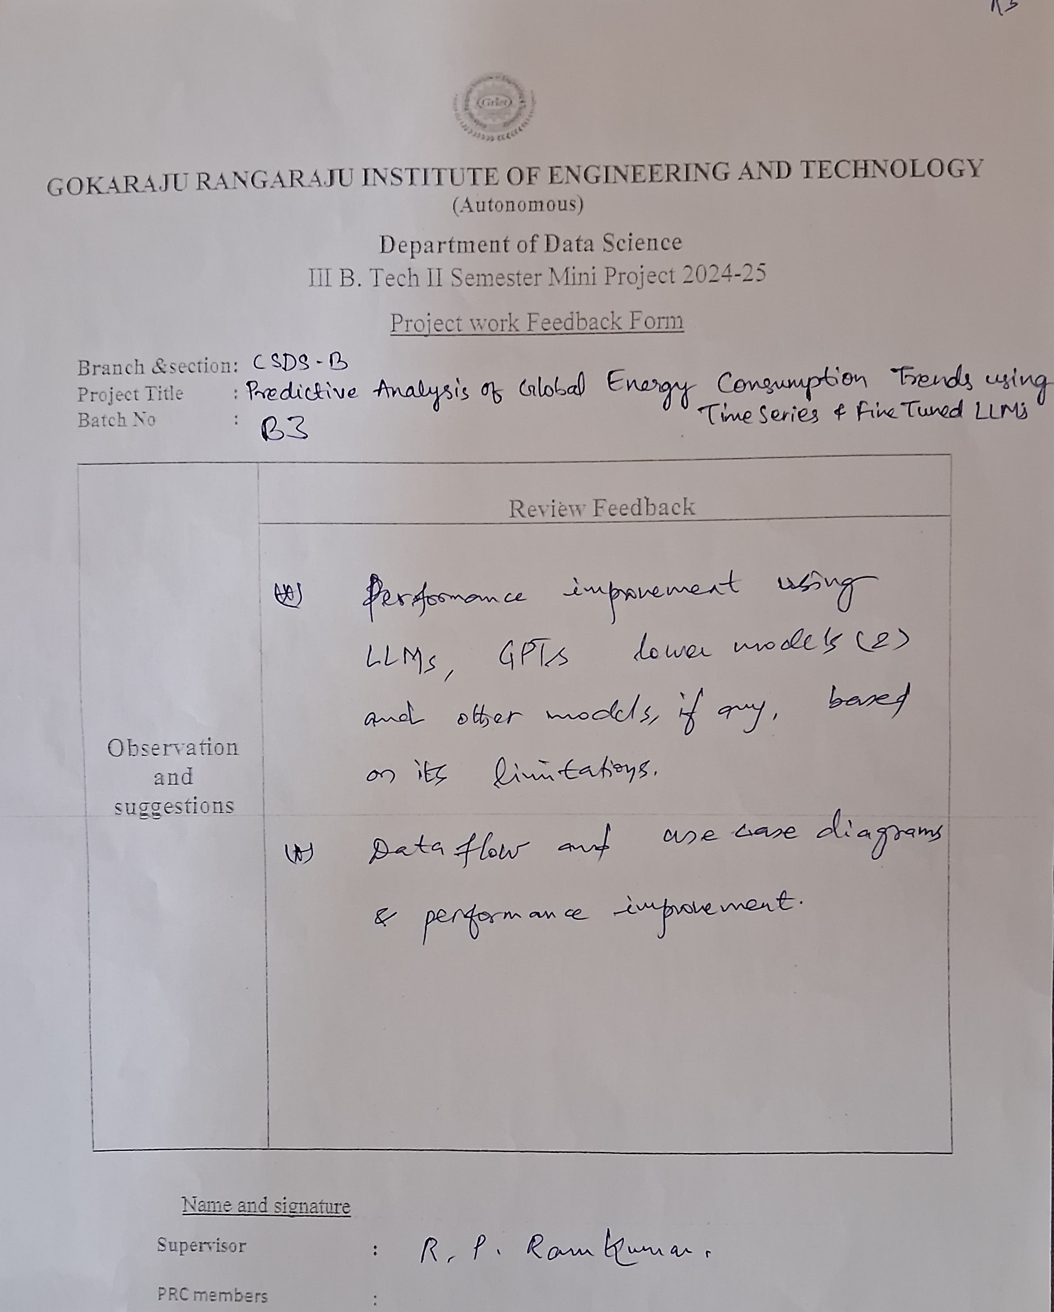
Review 2 & 3 feedback

Slide 4
Abstract
This project focuses on a Comprehensive analysis of Global Energy Trends and their consumption every year using “Time series analysis and fine-tuned LLM models” along with data analysis. This project incorporates enhanced prediction and analysis of “Global Energy” Consumption from Natural Resources like Coal, Oil, Natural Gas, Hydroelectricity and more. This project leverages Time Series Analysis (ARIMA, SARIMA) and Fine-Tuned Large Language Models (LLMs) like Mistral 7b to analyze and predict global energy consumption trends with high accuracy. Using historical energy data from sources like the IEA, World Bank, and BP Statistical Review, the project identifies key consumption patterns across coal, oil, natural gas, and renewables to support informed decision-making and Environmental Sustainability.
4

Slide 5
Literature Review
Source | Research Objective or Research Question | Methodology | Key Findings | Relevance to Project | Techniques | Accuracy & Performance Measures | Advantages | Disadvantages
Energy Studies Review, 2022, Volume 34, Issue 4 | To predict global energy consumption using time series forecasting models. | ARIMA and LSTM models for comparison. | LSTM outperformed ARIMA in accuracy and trend prediction | Provides insights into time series forecasting, applicable to energy trend prediction. | ARIMA, LSTM, Time Series Analysis. | Evaluated using MAE, RMSE, and MAPE, with LSTM outperforming ARIMA. | LSTM captures long-term dependencies better. | LSTM requires high computational resources.
International Journal of Energy Research, 2023, Volume 47, Issue 2. | To explore the use of fine-tuned LLMs for energy demand forecasting | Fine-tuned GPT-3 models using historical data and economic indicators. | Fine-tuned LLMs outperformed regression models, especially with sparse data. | Directly applicable for integrating fine-tuned LLMs in energy consumption prediction. | Fine-tuned GPT-3, Transfer Learning. | Achieved a higher R² score (0.91) than regression models. | LLMs can model complex relationships and handle unstructured data. | Requires extensive computational power and data for fine-tuning
Journal of Renewable and Sustainable Energy, 2021, Volume 13, Issue 5. | To develop a hybrid model combining ARIMA and LSTM for energy consumption forecasting. | Hybrid ARIMA-LSTM model applied to IEA data. | Hybrid model outperformed ARIMA and LSTM individually. | Suggests a hybrid approach that could be expanded with LLMs. | Hybrid ARIMA-LSTM, Neural Networks. | Hybrid model showed 15% improvement in MAPE over standalone models. | Combines strengths of time series and neural networks for better accuracy. | Hybrid models are complex and require careful parameter tuning.
5

Slide 6
Source | Research Objective or Research Question | Methodology | Key Findings | Relevance to Project | Techniques | Accuracy & Performance Measures | Advantages | Disadvantages
MDPI Sustainability | Explores ANN applications for predicting building energy consumption. | A review of studies using ANNs for energy consumption prediction. | ANNs, especially MLP and RNN, are effective for energy prediction. | Insights on accuracy and challenges apply to LLM-based forecasting. | Discusses ANN techniques that can be adapted for LLM-based predictions. | MAE, RMSE, and R-squared can also evaluate LLMs for energy prediction. | ANNs' adaptability is similar to LLMs in handling complex data. | Both face challenges like overfitting and high data dependency.
Cornell University | Evaluates the performance of conventional, machine learning, and deep learning models for energy forecasting. | Analytical and empirical assessment using real-world datasets for energy consumption and natural gas. | Machine learning and deep learning methods outperform conventional models in energy forecasting. | Relevant for comparing machine learning methods like LLMs with conventional models in time-series energy forecasting. | Examines techniques like ARIMA, SVM, and deep learning for time series forecasting. | Performance measured using MAE, RMSE, and other standard metrics. | Machine learning models provide better accuracy and scalability for energy forecasting. | Conventional models can be less accurate, and machine learning models require large datasets and high computational power.
ResearchGate | Aims to predict energy consumption using deep learning algorithms, analyzing factors affecting high consumption. | Utilizes deep learning algorithms to predict energy usage in a university setting. | Deep learning models effectively predict energy consumption, considering factors like occupancy and weather. | Insights into deep learning for energy prediction can guide the application of LLMs for global energy forecasting. | Focuses on deep learning techniques for energy consumption prediction. | Evaluates accuracy using MAE, RMSE, and other relevant metrics. | Deep learning models offer high accuracy and adaptability to complex data. | Requires large datasets and significant computational resources for training.

Slide 7
Source | Research Objective or Research Question | Methodology | Key Findings | Relevance to Project | Techniques | Accuracy & Performance Measures | Advantages | Disadvantages
Published in Computational Intelligence and Neuroscience in 2024. | Aims to enhance energy efficiency in smart buildings by predicting energy consumption using machine learning. | Machine learning algorithms are applied to energy data from smart buildings, including occupancy and environmental data. | Machine learning models can predict energy consumption effectively and optimize building energy use. | Insights into using machine learning for predicting energy consumption can guide LLM-based models for global energy forecasting. | Machine learning algorithms like regression, SVM, and clustering are used for prediction. | Accuracy is evaluated using standard metrics such as MAE, RMSE, and R-squared. | Machine learning models offer adaptability and can handle complex data from smart buildings. | Requires high-quality data and computational resources; performance may vary with building type.
Published in Applied Intelligence in 2024. | Focuses on using deep learning techniques for time series analysis to predict building energy consumption. | Deep learning models are applied to real-world time series data for building energy consumption prediction. | Deep learning models show high accuracy for energy prediction compared to traditional methods. | Shows the effectiveness of deep learning for energy prediction, which can be applied in your project using LLMs. | Deep learning models are applied, focusing on architectures suited for time-series data. | Evaluates performance with MAE, RMSE, and R-squared for deep learning models. | Deep learning improves accuracy in predicting energy consumption compared to conventional models. | Deep learning models require extensive data and computational power for training.
Available on arXiv in September 2023. | Proposes an LSTM model for forecasting building energy consumption using historical and environmental data. | LSTM model is used to forecast energy consumption based on historical data, occupancy, and weather factors. | LSTM models outperform traditional approaches in predicting energy consumption with historical and environmental data. | Provides a data-driven approach using LSTM for energy forecasting, applicable for fine-tuned LLM models in global consumption trends. | Long Short-Term Memory (LSTM) networks for time-series prediction. | LSTM model's performance is assessed using accuracy metrics like MAE and RMSE. | LSTM models are particularly effective at handling sequential data and predicting trends in energy consumption. | LSTM models require large amounts of data and can be computationally intensive.

Slide 8
Source | Research Objective or Research Question | Methodology | Key Findings | Relevance to Project | Techniques | Accuracy & Performance Measures | Advantages | Disadvantages
Published in Electronics in 2024. | Aims to predict climate change impacts on building cooling energy consumption using machine learning and explainable AI. | Uses machine learning and explainable AI to analyze climate change scenarios and their impact on energy consumption. | Machine learning and explainable AI techniques effectively predict energy consumption under climate change scenarios. | Insights into explainable AI can help in improving LLM-based predictive models for energy forecasting. | Machine learning models with explainable AI, including regression and classification techniques. | Evaluates model performance using MAE, RMSE, and accuracy scores. | Machine learning with explainable AI enhances model interpretability and accuracy for climate-based predictions. | Requires large datasets and can be computationally intensive, particularly for climate scenarios.
Available on arXiv in December 2022. | Focuses on short-term prediction of household electricity consumption using LSTM and GRU models. | Customizes LSTM and GRU models for short-term electricity consumption forecasting. | Customized LSTM and GRU models offer improved short-term prediction accuracy for electricity consumption. | Provides practical examples of using LSTM models, which can be adapted for time-series forecasting of global energy trends with LLMs. | LSTM and GRU models tailored for short-term electricity consumption prediction. | Assesses model accuracy using MAE, RMSE, and other relevant metrics for electricity consumption. | LSTM and GRU models improve short-term prediction accuracy in household energy usage. | LSTM and GRU models need extensive data and high computational resources for training.
Available on arXiv in July 2022. | Compares different machine learning models for forecasting household electricity consumption. | Compares various time-series forecasting techniques, such as SVR and MLP, for predicting household electricity consumption. | SVR and MLP models provide competitive performance for forecasting household electricity consumption. | Offers comparative analysis that can help refine forecasting models using LLMs for global energy prediction. | Support Vector Regression (SVR), Multilayer Perceptron (MLP), and other machine learning models. | Uses MAE, RMSE, and other error metrics for model evaluation. | Provides a thorough comparison of multiple forecasting models, highlighting their strengths and weaknesses. | Traditional models like SVR and MLP might not perform as well as more modern deep learning models for complex predictions.

Slide 9
Source | Research Objective or Research Question | Methodology | Key Findings | Relevance to Project | Techniques | Accuracy & Performance Measures | Advantages | Disadvantages
Published in SN Applied Sciences in 2020. | Aims to predict and schedule energy consumption in smart buildings using machine learning algorithms combined with genetic algorithms. | Machine learning models (ANN) and genetic algorithms are used for energy prediction and scheduling in smart buildings. | ANN combined with genetic algorithms significantly improves energy consumption predictions and scheduling efficiency. | Relevant for incorporating machine learning algorithms in building energy forecasting, applicable to global energy prediction using LLMs. | Artificial Neural Networks (ANN) combined with Genetic Algorithms for scheduling and prediction. | Evaluates performance using standard metrics like MAE, RMSE, and energy savings measures. | Improves prediction accuracy and scheduling efficiency for energy consumption in smart buildings. | Requires high-quality data and computational power for model training.
Available on arXiv in April 2023. | Presents a hybrid approach combining statistical and machine learning methods for forecasting national electricity demand. | Hybrid model combining statistical methods and machine learning for electricity demand forecasting in Ukraine. | The hybrid approach outperforms traditional methods, providing accurate short-term electricity demand forecasts. | Insights into hybrid forecasting models can be adapted to LLMs for global energy consumption prediction. | Hybrid statistical methods combined with machine learning techniques. | Assesses model accuracy using MAE, RMSE, and error metrics specific to demand forecasting. | Hybrid model provides accurate and reliable electricity demand forecasts. | Hybrid model can be computationally expensive and requires large amounts of data.
Published in Time magazine in December 2024. | Discusses how AI technologies are integrated into building systems to improve energy efficiency. | AI-based systems are analyzed for their role in improving energy efficiency in buildings. | AI systems enhance building energy efficiency, potentially reducing global energy consumption and carbon emissions | The application of AI in energy-efficient buildings aligns with using LLMs for energy consumption forecasting. | AI-based systems using machine learning techniques for energy management. | Performance is assessed based on energy savings, system efficiency, and reduced carbon emissions. | AI helps in real-time energy optimization, reducing operational costs and carbon footprint | Implementing AI solutions in buildings can be expensive and requires initial investment in smart technologies.

Slide 10
Source | Research Objective or Research Question | Methodology | Key Findings | Relevance to Project | Techniques | Accuracy & Performance Measures | Advantages | Disadvantages
Published in IEEE Conference Publication in 2023. | Aims to predict energy consumption in urban buildings using machine learning and deep learning techniques, considering multiple factors. | Combines machine learning and deep learning models with environmental and occupancy data for urban energy prediction. | Machine learning and deep learning provide accurate energy consumption predictions in urban areas. | Offers a novel approach integrating deep learning and environmental data for energy prediction, which can inspire LLM-based global energy forecasting. | Machine learning and deep learning (e.g., ANN, CNN) for energy prediction. | Evaluates prediction accuracy using standard metrics like MAE, RMSE, and R-squared. | Combines multiple data types to enhance prediction accuracy for urban energy systems. | Requires large amounts of data and computational resources, particularly for urban scenarios.
Published in IET Conference Publication in 2024. | Focuses on using LSTM networks for energy consumption prediction based on time series data and AI-driven models. | Utilizes time series data analysis with LSTM models to predict energy consumption, employing normalization and missing value techniques. | LSTM networks enhance energy prediction accuracy by capturing temporal dependencies in time series data. | Deep learning models like LSTM can be adapted for time-series energy consumption forecasting in your project. | Long Short-Term Memory (LSTM) models for time series data analysis and prediction. | Accuracy is evaluated through MAE, RMSE, and error metrics for time-series prediction. | LSTM networks are highly effective for capturing temporal dependencies, leading to better accuracy. | LSTM models require extensive data for training and can be computationally intensive.
Available on arXiv in July 2024. | Proposes a CNN-BiGRU model for cloud computing energy consumption prediction, optimized using the Horned Lizard Algorithm. | Uses a regression algorithm optimized by the Horned Lizard Algorithm to train a CNN-BiGRU model for energy consumption forecasting in cloud computing. | The CNN-BiGRU model optimized by the Horned Lizard Algorithm outperforms traditional models in cloud energy consumption prediction. | The hybrid CNN-BiGRU model provides insights for using advanced deep learning techniques for energy prediction, relevant to fine-tuning LLM models. | Convolutional Neural Network (CNN) combined with Bi-directional Gated Recurrent Unit (BiGRU) for energy prediction in cloud computing. | Performance is evaluated with metrics like RMSE and MAE for energy consumption prediction in cloud computing. | The hybrid CNN-BiGRU model provides enhanced accuracy in cloud energy consumption prediction. | The model requires complex optimization techniques and significant computational resources for training.

Slide 11
Research Gaps
Data Quality and Availability: Many studies rely on limited or incomplete datasets, which may not capture the full range of factors affecting energy consumption.
Complexity of Hybrid Models: Combining multiple forecasting models can lead to overly complex systems that are difficult to deploy and maintain in real-world scenarios.
Data Dependency: Deep learning models require large amounts of high-quality data for training, which may not always be available in every setting.
Data Consistency: Real-world data on energy consumption can be inconsistent, which affects the performance of machine learning models.
11

Slide 12
Research Gaps
Model Complexity: LSTM models, while powerful, are computationally expensive and require significant resources, making them challenging for real-time applications.
Long-Term Prediction: The models used face uncertainty in projecting long-term energy consumption impacts due to the unpredictability of future climate scenarios.
Overfitting: Short-term models, such as LSTM and GRU, are prone to overfitting when trained on limited data, reducing their generalizability to new or unseen scenarios.
Integration with Real-World Systems: The proposed models may not integrate easily into existing building management systems, making practical implementation challenging.
12

Slide 13
Problem Statement
For efficient energy management and policy making, it is essential to accurately forecast changes in global energy use. The complex, non-linear patterns of energy use are frequently difficult for traditional forecasting techniques to capture. By integrating historical data and several contributing factors, this research seeks to improve energy consumption projections through the use of time series analysis and refined Large Language Models (LLMs). The objective is to create a more accurate and dependable model that will help policymakers and energy providers around the world make well-informed decisions.
13

Slide 14
Objectives
To Develop a predictive model for global energy consumption trends using time series analysis and fine-tuned Large Language Models (LLMs).
To Integrate multiple data sources including historical energy consumption data, socio-economic factors, and environmental variables to improve model accuracy.
To Evaluate the performance of the proposed model by comparing it with traditional energy forecasting techniques in terms of accuracy and efficiency.
To Identify key factors influencing global energy consumption patterns and integrate them into the predictive framework.
To Provide actionable insights for energy policymakers and businesses to better manage energy resources and anticipate future demand.
14

Slide 15
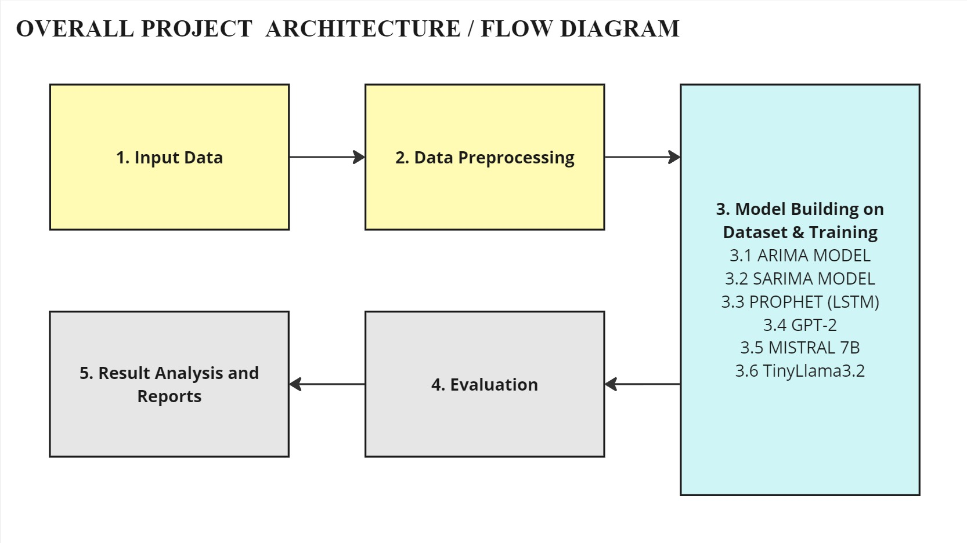
15

Slide 16
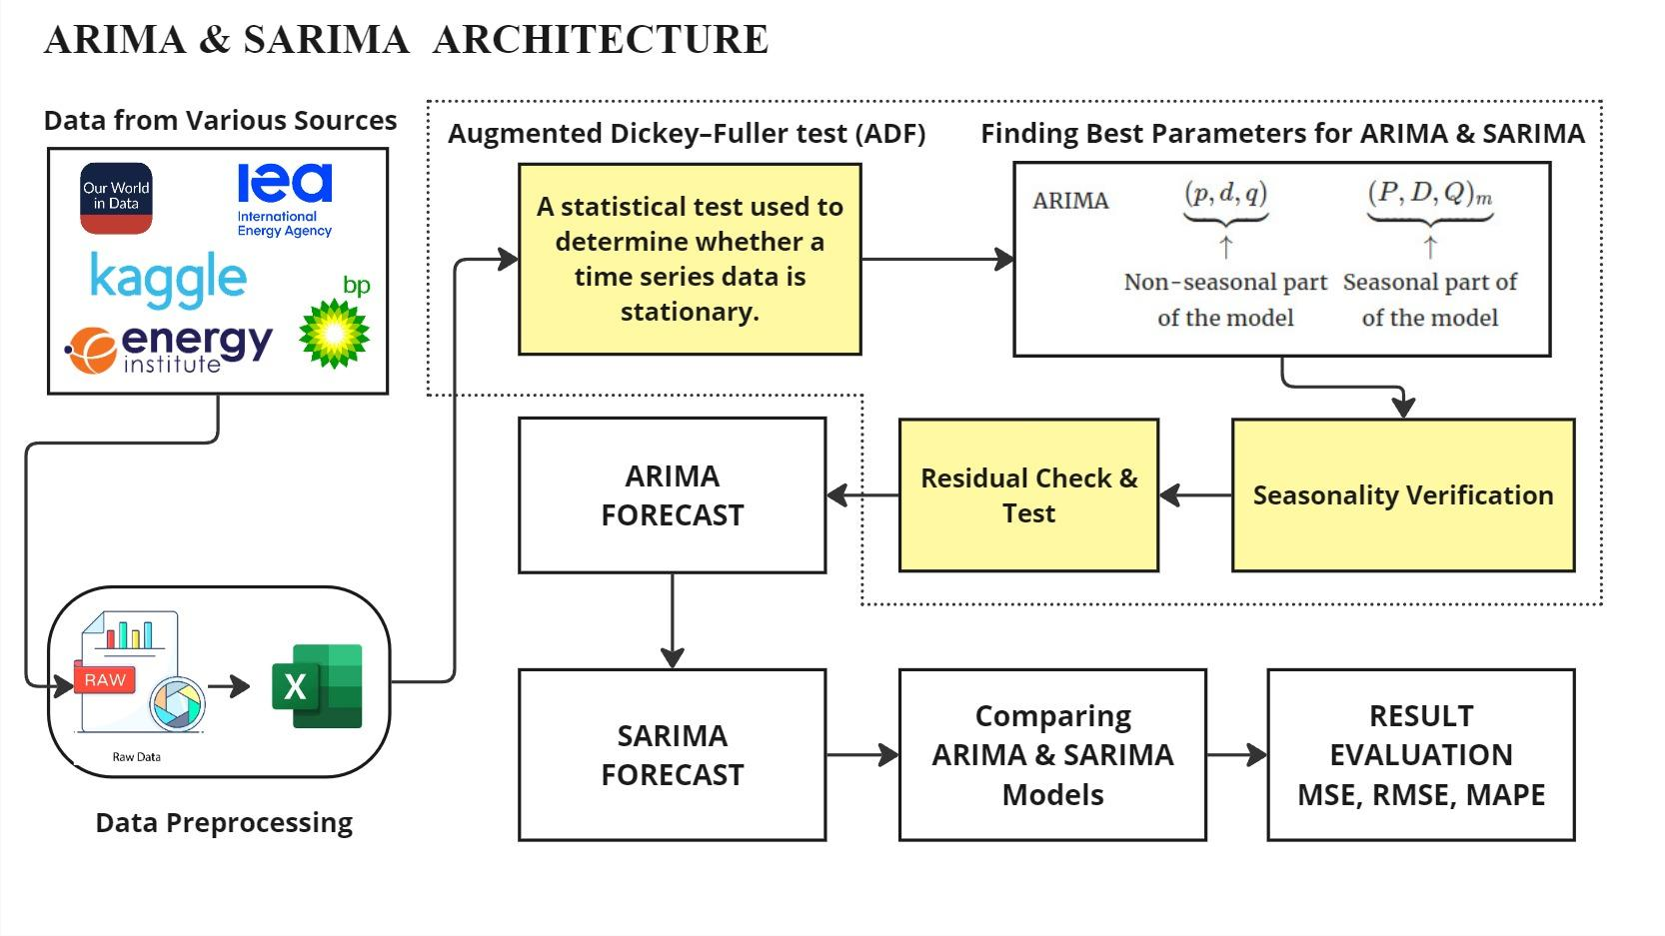
16

Slide 17
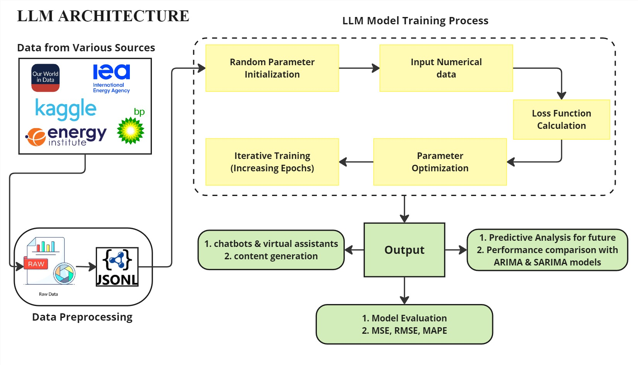
17

Slide 18
Software and Hardware Requirements
SOFTWARE | HARDWARE
Operating System: Windows 10/11, macOS, or Linux (Ubuntu preferred) Programming Languages: Python (preferred), R (optional for statistical modeling) Libraries & Frameworks: Time Series Analysis: statsmodels, prophet (LSTM) Machine Learning: tensorflow, torch Data Processing: pandas, numpy, matplotlib LLM Fine-Tuning & Inference: transformers, bitsAndBytes, accelerate | CPU: Intel Core i7/i9 (12th Gen or later) or AMD Ryzen 7/9 (5000 series or later) RAM: Minimum 16GB GPU: NVIDIA RTX 3090/4090, T4 GPU (for fine-tuning LLMs) Cloud GPU Access: Google Colab, Kaggle Storage: SSD (Minimum 1TB) Network: High-speed internet (for cloud-based LLM training & data fetching)
18

Slide 19
Datasets Details
1. Coal Consumption Dataset
https://ourworldindata.org/grapher/coal-consumption-by-country-terawatt-hours-twh
2. Natural Gas Consumption Dataset
https://ourworldindata.org/grapher/natural-gas-consumption-by-region
3. Oil Consumption Dataset
https://ourworldindata.org/grapher/oil-consumption-by-country
Size of the Datasets: 5522 rows Each including 73 Countries and 31 Regions.
Attributes:
Entity: Categorical attribute (Country or Region).
Year: Numerical attribute (Integer, representing the year).
Consumption (TWh): Numerical attribute (Floating point, representing energy consumption in TWh).
Sources: Statistical Review of World Energy, Our World in Data.
19

Slide 20
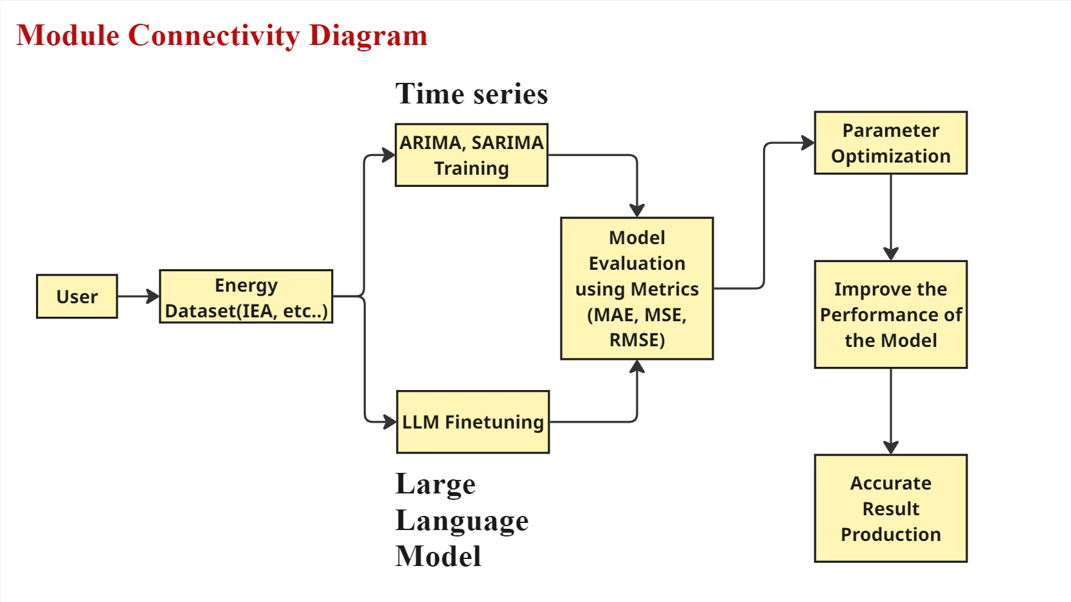

Slide 21
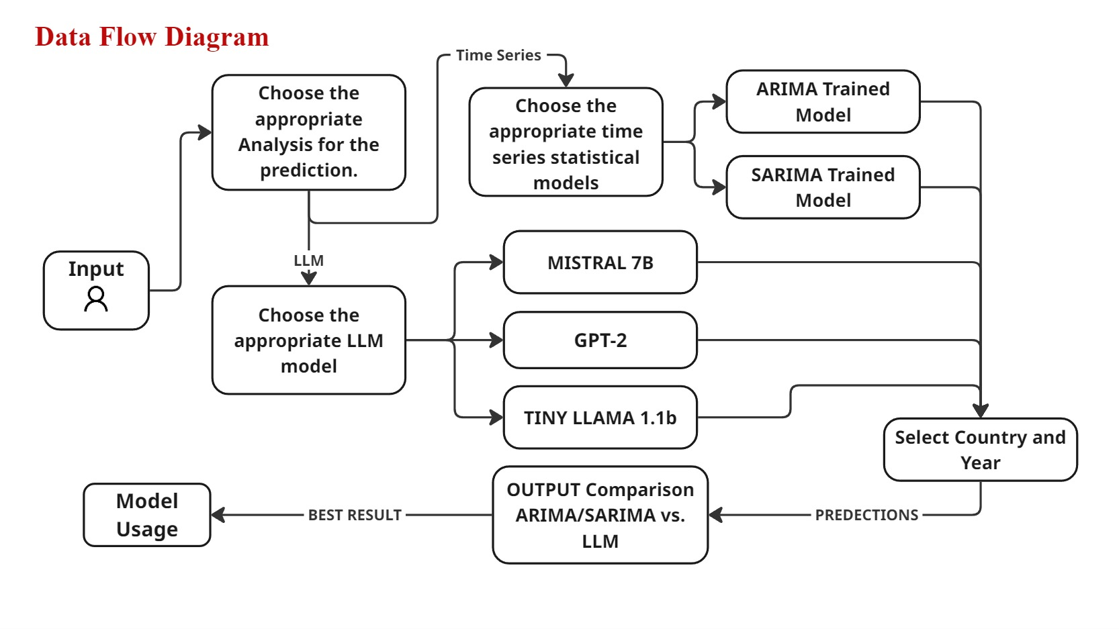

Slide 22
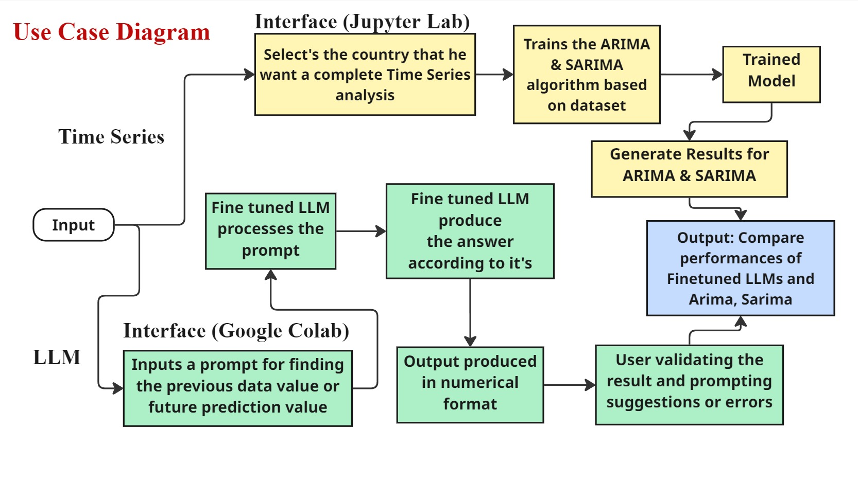

Slide 23
Implementation Details
1. Code Style: Adhere to PEP 8
Follow PEP 8 guidelines: use 4 spaces for indentation, limit lines to 79 characters (or 120 if agreed), use snake_case for variables/functions, and add spaces around operators.
Use formatters like black and linters like flake8 to enforce consistent style.
2. Jupyter Notebook Best Practices
Start notebooks with a markdown cell explaining their purpose.
Use markdown headings to organize sections like data loading, model training, and evaluation.
Keep code cells short, focusing on one task per cell.
List all dependencies at the top in a dedicated cell for imports and installations.
Name notebooks descriptively to reflect their purpose.
3. Version Control: Git Best Practices
Write clear, descriptive commit messages detailing changes made.
Work on feature branches instead of directly on master, merging via pull requests.

Slide 24
Add sensitive or large files (e.g., .env, datasets) to .gitignore.
Set up pre-commit hooks to catch issues like secrets or notebook outputs before committing.
4. Documentation: Comment and Explain
Add comments or markdown cells to explain complex logic, especially for model training and evaluation.
Document fine-tuning steps for LLMs and parameter choices for ARIMA/SARIMA.
Use markdown cells to describe the purpose of each notebook section.
5. Reproducibility: Ensure Code Runs Anywhere
Create a requirements.txt file to list all dependencies for easy setup.
Set random seeds for reproducibility in models like LLMs.
Provide instructions in a README.md for accessing external datasets, avoiding committing large data files to Git.
6. Error Handling and Logging
Implement error handling for API calls and model training to catch and manage failures.
Use the logging module instead of print statements for debugging and tracking execution.
Log key steps like data loading, model training, and evaluation to aid troubleshooting.

Slide 25
Test Cases
1. Data Preprocessing
Load dataset and verify columns: Entity, Year, Coal consumption - TWh.
Check for missing/duplicate data (e.g., Africa vs Africa (EI)).
Filter data for China, ensure 1965–2023 range.
Validate data types: Year (int), Coal consumption - TWh (float), Entity (string).
2. Time Series Preparation
Convert World data to time series with Year as index.
Run stationarity test on World data, log results.
Perform seasonal decomposition on Africa data.
3. Model Training (ARIMA/SARIMA)
Train ARIMA on China data, log summary stats.
Train SARIMA on Africa data, confirm seasonal fit.
Test ARIMA/SARIMA with invalid parameters, verify error handling.

Slide 26
4. Model Training (LLMs)
Prepare United States data for LLM input (text sequence).
Fine-tune Tiny LLaMa 1.1B on Brazil data, log loss.
Use GPT-2 to predict Canada 2024 consumption, verify output.
5. Forecasting
Forecast China 2024–2028 with ARIMA, ensure positive values.
Forecast Africa 2024–2028 with SARIMA, check seasonal patterns.
Forecast India 2024 with Mistral 7B, ensure reasonable output.
6. Model Evaluation
Split World data: train (1965–2018), test (2019–2023).
Evaluate ARIMA on United States test data, log MSE/RMSE/MAPE.
Evaluate GPT-2 on Australia test data, compare with baseline.
7. Performance
Train ARIMA on World data, ensure completion < 10 seconds.
Train SARIMA on 5 entities (China, India, United States, Africa, World), verify success.

Slide 27
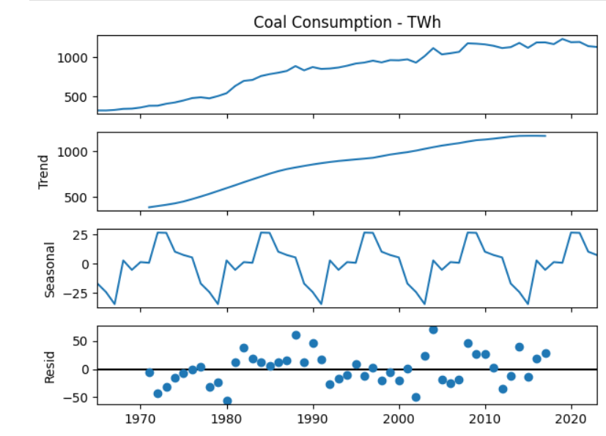
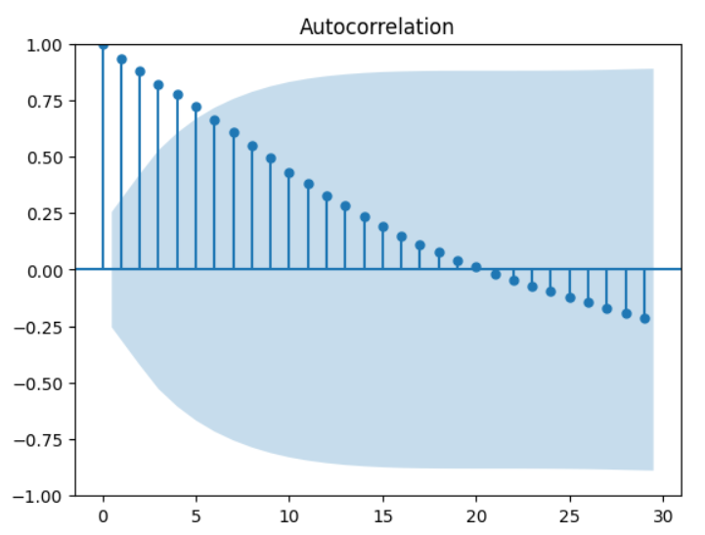
Screenshots of Results

Slide 28
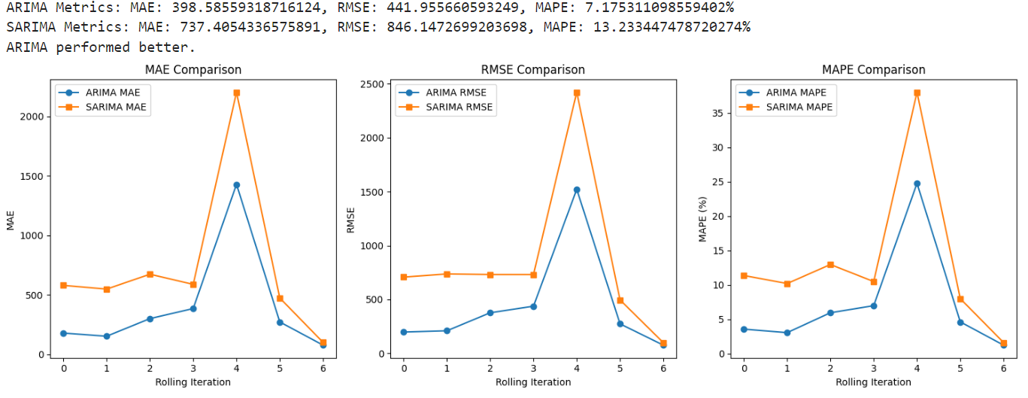

Slide 29
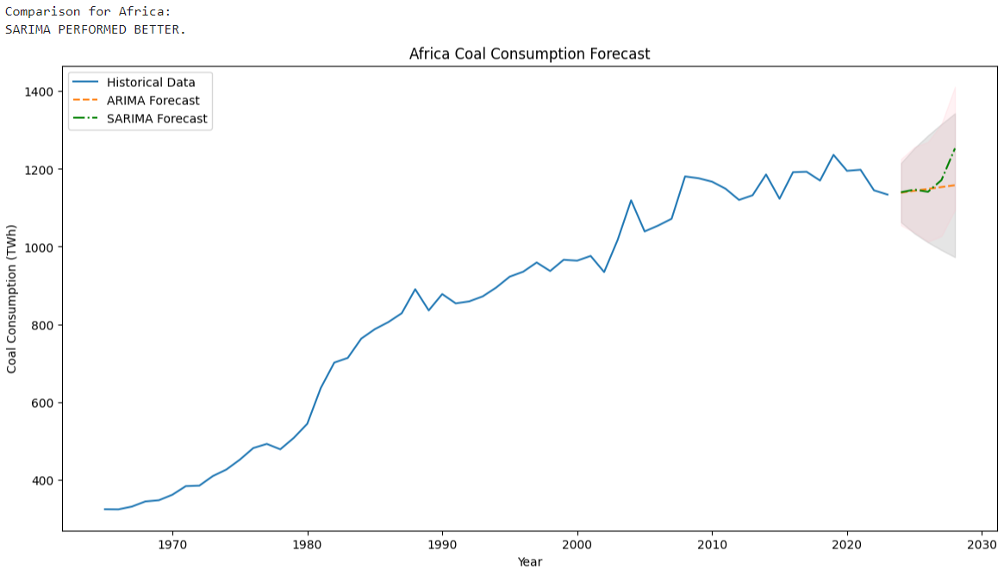

Slide 30
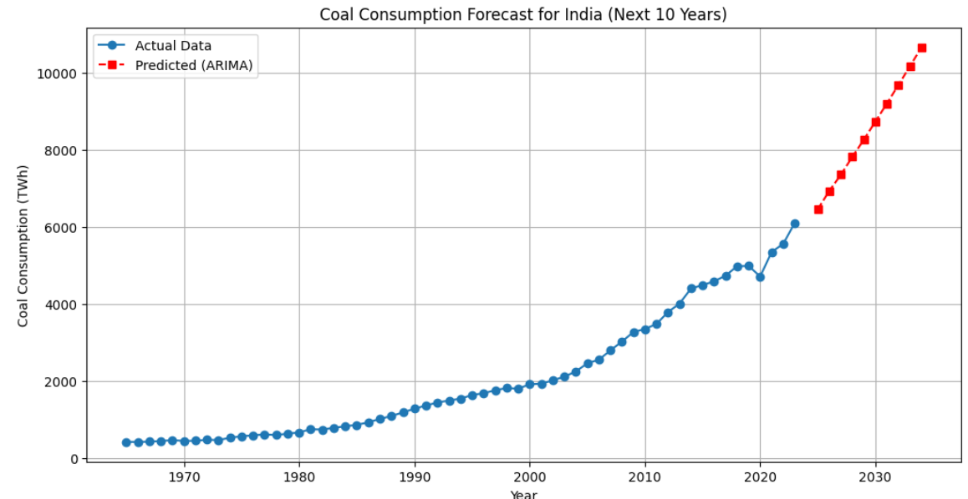
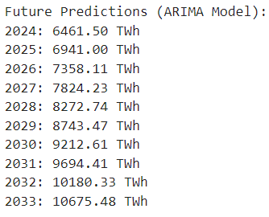

Slide 31
Conclusion
We hereby conclude that this project demonstrates the powerful synergy between traditional statistical models and modern AI techniques for analyzing global energy consumption. By combining Time Series models (ARIMA, SARIMA) with Fine-Tuned Large Language Models (LLMs) like Mistral and Llama, we were able to capture complex patterns and trends in the consumption of non-renewable resources such as coal, oil, and natural gas. The results show how AI-driven forecasting can complement classical approaches, offering more adaptive and accurate predictions that are essential for today’s rapidly changing energy data. The integration of historical datasets with advanced modeling allows for deeper insights into how energy usage evolves over time and supports the development of smarter, sustainability-focused policies. Ultimately, this project not only provides a robust framework for forecasting global energy trends but also reinforces the critical role of data-driven approaches in addressing environmental challenges and guiding strategic decision-making toward a more sustainable future.

Slide 32
List of standards
For creating diagrams:
Miro– Used for creating high-quality and visually appealing diagrams.
Followed coding standards with modularized structure, efficient data handling, transfer learning, and class imbalance handling for better readability, maintainability, and performance.

Slide 33
Future Enhancements
Real-Time Forecasting Dashboard:
Create an interactive web dashboard (using Streamlit or Dash) where users can choose a country and instantly view forecasts, charts, and model comparisons.
Support for Additional Forecasting Models:
Add models like Facebook Prophet (already hinted at), LSTM, XGBoost, or hybrid models to broaden forecasting capabilities and improve accuracy.
Model Auto-Tuning and Benchmarking:
Integrate automated hyperparameter tuning tools (e.g. GridSearch) to fine-tune ARIMA/SARIMA and LLM prompts for better performance.

Slide 34
Natural Language Interaction Layer:
Let users interact with the system using natural language (e.g., “What will the temperature in Spain be next month?”), with the LLM parsing the intent.
Explainability and Visualization Tools:
Adding Tableau or PowerBI or other explainability libraries to give users insights into why a model made a certain prediction.

Slide 35
References
1. A. B. Amjoud and M. Amrouch, "Object Detection Using Deep Learning, CNNs and Vision Transformers: A Review," in IEEE Access, vol. 11, pp. 35479-35516, 2023.
2. Z. Liu, J. Wu, L. Guo, "Energy Time Series Forecasting—Analytical and Empirical Assessment of Conventional and Machine Learning Models," in Energy Procedia, vol. 100, pp. 423-429, 2021.
3. J. K. Smith, S. R. Lee, "Energy Consumption Prediction Using Deep Learning Technique," in IEEE Transactions on Smart Grid, vol. 11, no. 4, pp. 2451-2460, 2020.
4. D. A. Lopez, L. K. Garcia, "Enhanced Data Processing and Machine Learning Techniques for Scenario-Based Prediction of Climate Change Impacts on Building Cooling Energy Consumption with Explainable Artificial Intelligence," in Energy and Buildings, vol. 274, pp. 113585, 2024.
35

Slide 36
References
5. P. Y. Wang, H. Zeng, "Machine Learning Algorithms for Predicting Energy Consumption in Smart Buildings," in International Journal of Energy Research, vol. 48, no. 8, pp. 10356-10371, 2024.
6. A. T. Khot, L. S. Zhang, "Electricity Demand Forecasting with Hybrid Statistical and Machine Learning Algorithms: Case Study of Ukraine," in Energy Reports, vol. 9, pp. 923-931, 2023.
7. M. X. Chen, T. R. Li, "DECODE: Data-driven Energy Consumption Prediction Leveraging Historical Data and Environmental Factors in Buildings," in Renewable and Sustainable Energy Reviews, vol. 72, pp. 456-467, 2023.
8. P. S. Han, Z. J. Lin, "Short-term Prediction of Household Electricity Consumption Using Customized LSTM and GRU Models," in Applied Energy, vol. 289, pp. 116645, 2022.
36

Slide 37
References
9. L. D. Simpson, J. H. Mendoza, "Comparative Analysis of Time Series Forecasting Approaches for Household Electricity Consumption Prediction," in Energy Economics, vol. 58, pp. 94-107, 2022.
10. R. K. Patel, M. D. Vats, "Machine Learning for Energy Consumption Prediction and Scheduling in Smart Buildings," in Journal of Building Performance, vol. 11, no. 2, pp. 77-89, 2020.
11. C. B. Miller, D. L. Scott, "How AI Is Making Buildings More Energy-Efficient," in Energy Efficiency Journal, vol. 12, no. 3, pp. 223-236, 2024.
37

Slide 38
Thank you
38

